Slide 1
PG4200: Algorithms And Data Structures Lesson 09: Graphs
Bogdan Marculescu

Slide 2
Graphs
A set of vertices connected by edges
Directed or Undirected graphs
If edge from X to Y, implies edge from Y to X?
Many different problems can be represented with graphs
Many different algorithms specialized for graphs
Here just having a very high level view
0
1
2
3
4
6
5
7
8
9

Slide 3
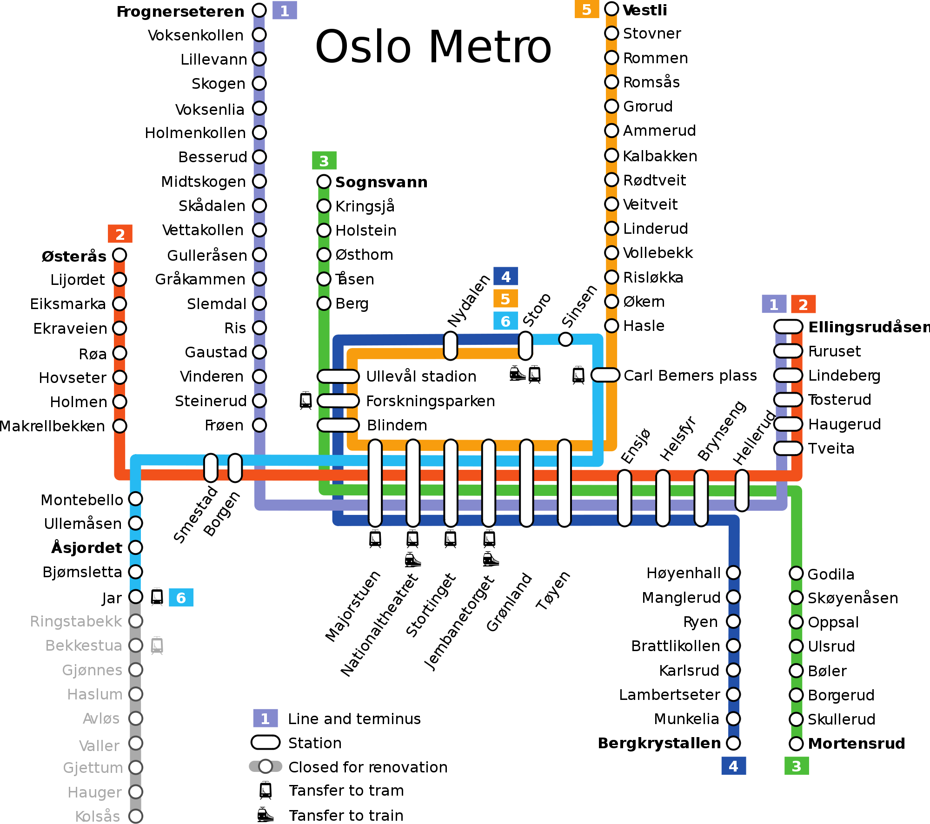

Slide 4
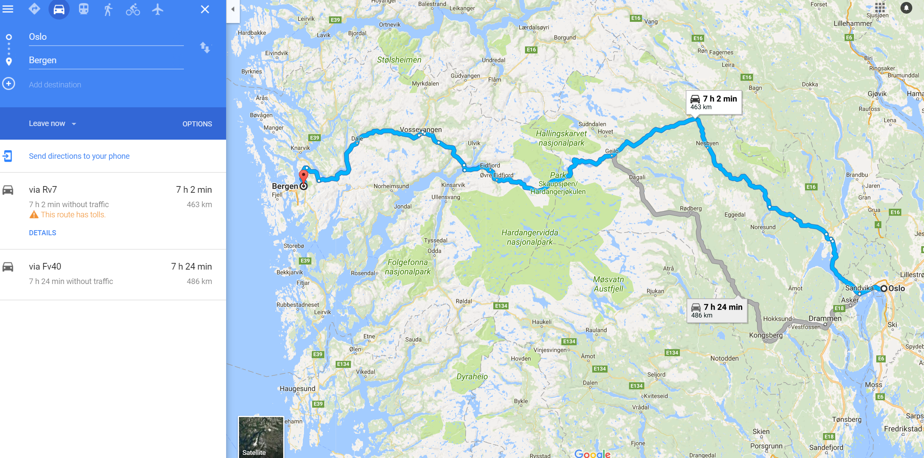

Slide 5
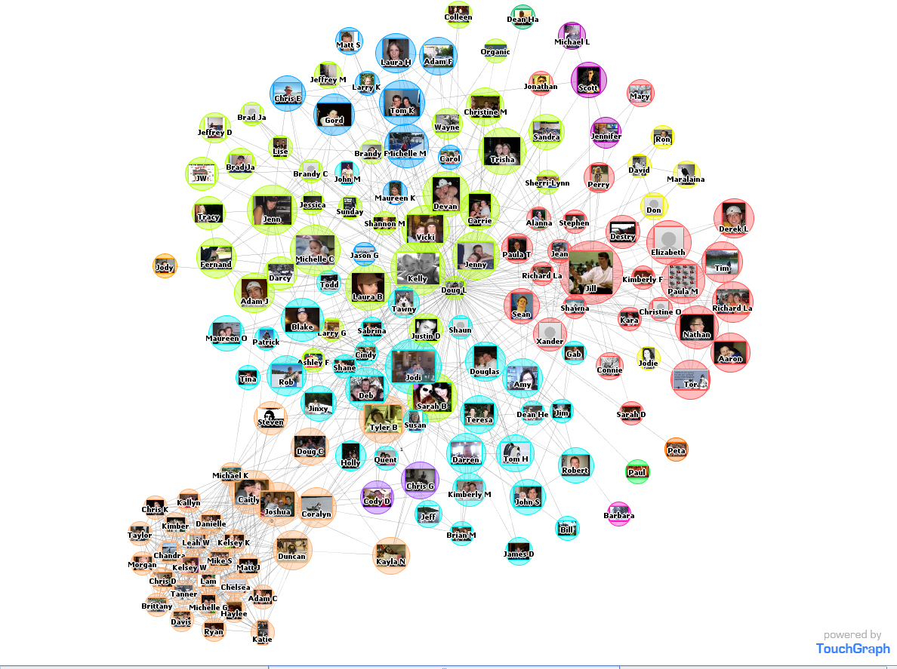
Friends in a social network

Slide 6
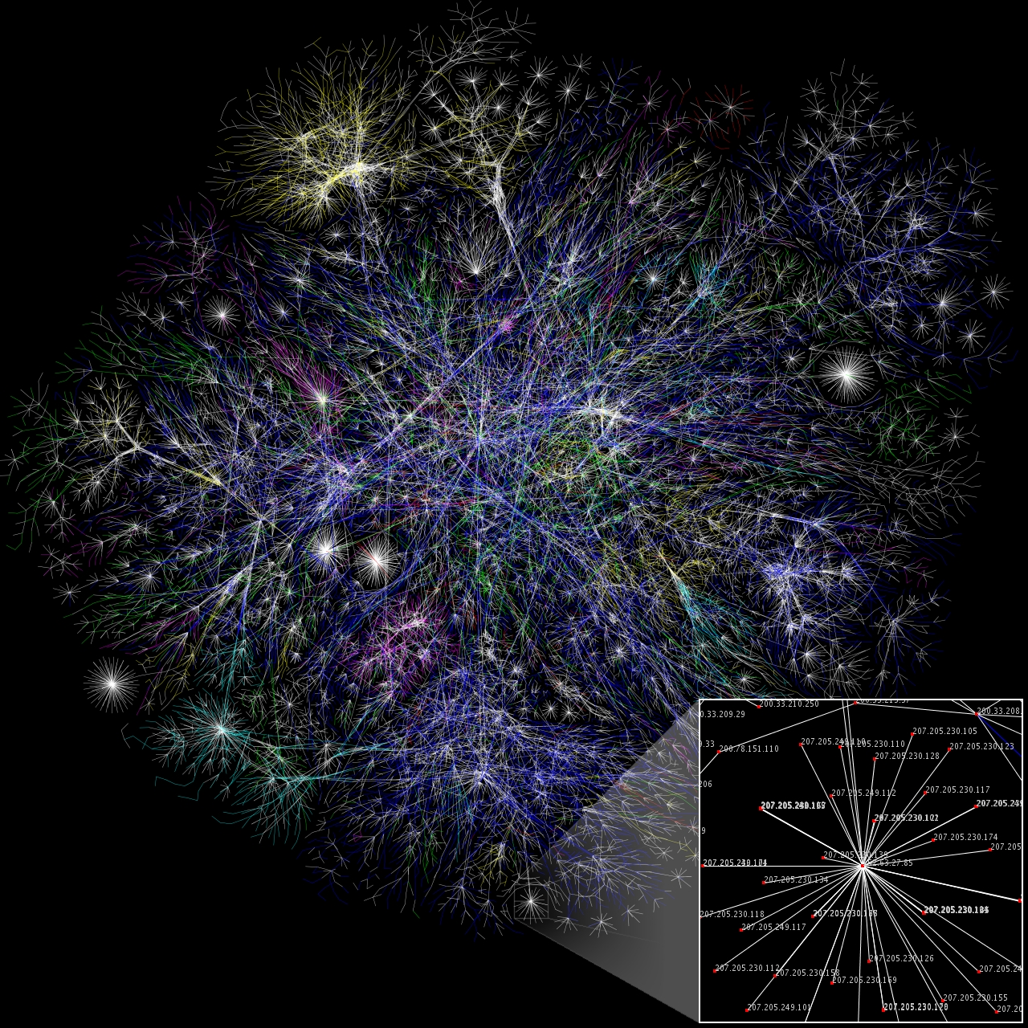
Machines connected on internet
Note: the picture only show a tiny subset of the whole internet graph…

Slide 7
Terminology
Vertex: a node, for which can use a label to identify it
Edge: connection between 2 nodes
Path: a sequence of connected nodes
Cycle: a path starting and ending on the same node
Note: in a graph, not all nodes are necessarily connected
vertex
0
cycle 2,4,3,2
edge
1
2
connected components
3
4
6
path 6,7,5,8
5
7
8
9

Slide 8
How to represent a graph?
Vertices can be object with state
Eg, name of station, city, friend, IP address
“Map” from vertex X (key) to a collection of vertices (value) reachable from X
Note: in this way, do not need objects to explicitly represent edges

Slide 9
Operations
Given an existing graph, there can be different operations we might need to do
Path Finding: given two vertices (eg, 2 cities), find a path connecting them, and avoiding cycles

Slide 10
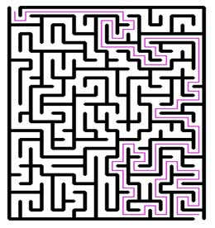
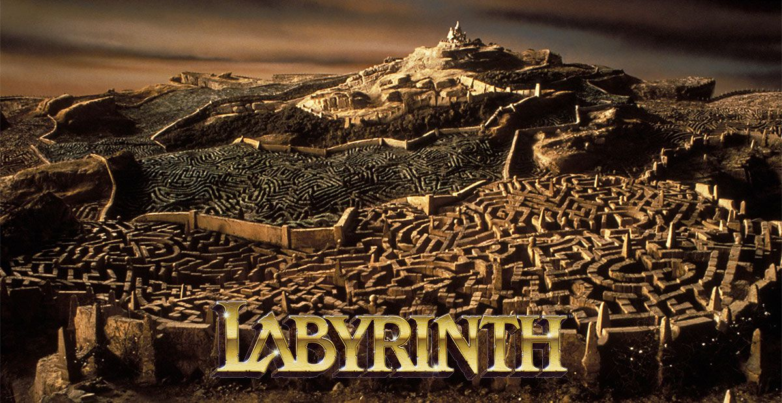
Maze / Labyrinth
Mazes can be represented with a graph
Vertices: intersections
Edges: passages between two intersections
Find path from starting vertex to the vertex of the exit

Slide 11
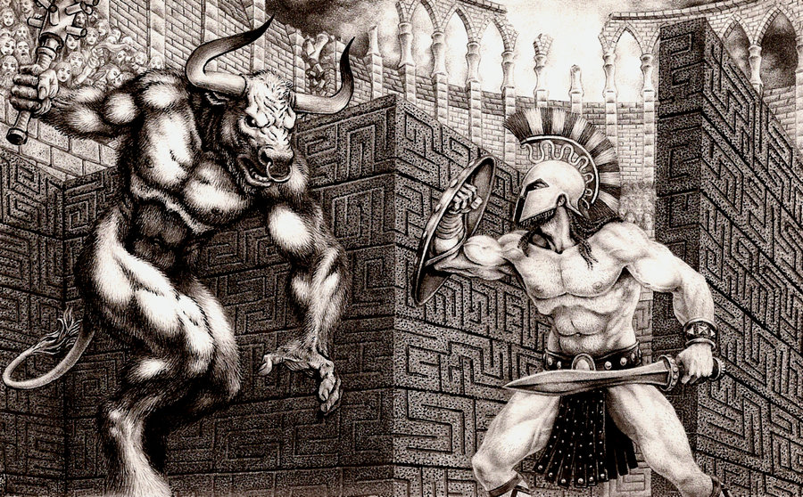
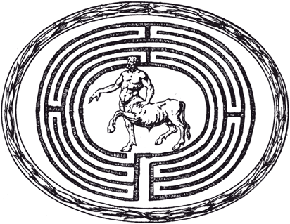

Thesus vs. the Minotaur
Thesus slays the Minotaur at the center of the labyrinth
Used a thread to trace back the exit

Slide 12
Trémaux's Algorithm
Charles Pierre Trémaux, 19th-century
Method that guarantees to find an exit in a maze
Note: talking about actual mazes, not computers…
Trémaux's Algorithm is an instance of what we now call Depth-First Search in graphs

Slide 13
Depth-First Search (DFS)
Try to find a path from vertex X to Y
Mark current vertex as visited
Recursively look at each connected vertex from the current
But skip already marked vertices (eg, by using a set)
Use stack to represent path from X toward current vertex
Push when recursively evaluate a connected vertex
Pop when backtrack out of a recursive call

Slide 14
Example
X
X
0
Y
0
Y
1
1
3
2
3
2
5
5
4
4
Visited: X
Stack: X
Connected: 0, 1, Y

Slide 15
Recursion on 0
X
X
0
Y
0
Y
1
1
3
2
3
2
5
5
4
4
Visited: X, 0
Stack: X, 0
Connected: (X)

Slide 16
Backtrack to X
X
X
0
0
Y
Y
1
1
3
2
3
2
5
5
4
4
Visited: X, 0
Stack: X
Connected: (0), 1, Y

Slide 17
Evaluating 1 and then 3
X
X
0
0
Y
Y
1
1
3
2
3
2
5
5
4
4
Visited: X, 0, 1
Stack: X, 1
Connected: (X),3, 2
Visited: X, 0, 1, 3
Stack: X, 1, 3
Connected: (1), 4, 5

Slide 18
Evaluating 5 and then 4
X
X
0
Y
0
Y
1
1
3
2
3
2
5
5
4
4
Visited: X, 0, 1, 3, 5
Stack: X, 1, 3, 5
Connected: (3), 4
Visited: X, 0, 1, 3, 5, 4
Stack: X, 1, 3, 5, 4
Connected: (3), (5)

Slide 19
Backtracking Till 1
X
X
0
Y
0
Y
1
1
3
2
3
2
5
5
4
4
Visited: X, 0, 1, 3, 5, 4
Stack: X, 1, 3, 5, 4
Connected: (3), (5)
Visited: X, 0, 1, 3, 5, 4
Stack: X, 1
Connected: (X), (3), 2

Slide 20
Evaluating 2 and 1
X
X
0
Y
0
Y
1
1
3
2
3
2
5
5
4
4
Visited: X, 0, 1, 3, 5, 4, 2
Stack: X, 1, 2
Connected: (1), Y
Visited: X, 0, 1, 3, 5, 4, 2, Y
Stack: X, 1, 2, Y
Connected: (X), (2)

Slide 21
Final Path X, 1, 2, Y
X
X
X
0
Y
Y
Y
1
1
3
2
2
We found a path (which is stored in the stack), but it is not necessarily the shortest (which would be X-Y)
5
4
Visited: X, 0, 1, 3, 5, 4, 2, Y
Stack: X, 1, 2, Y
Connected: (X), (2)

Slide 22
Breadth-First Search (BFS)
DFS no guarantee to find shortest path, whereas BFS does
From starting point X, look at all paths of length 1, then all paths of length 2, then 3, … then N, until found Y or visited whole graph
Considering paths without cycles

Slide 23
Paths Starting From X
X
X
X
X
X
X
X
X
X
X
X
X
X
X
X
X
X
X
0
1
Y
1
1
Y
1
1
1
Y
1
1
Y
Y
Y
Y
Y
3
2
2
3
3
2
2
3
3
2
2
2
2
2
5
4
Y
1
5
4
1
1
1
1
1
X
4
5
3
3
3
3
3
0
Y
1
2 paths to Y,
of length 2 and 4
5
4
5
4
3
2
4
5
5
4

Slide 24
From X to 5
X
X
X
X
X
X
X
X
X
X
X
X
X
X
X
X
X
X
0
1
Y
1
1
Y
1
1
1
Y
1
1
Y
Y
Y
Y
Y
3
2
2
3
3
2
2
3
3
2
2
2
2
2
5
4
Y
1
5
4
1
1
1
1
1
X
4
5
3
3
3
3
3
0
Y
1
5
4
5
4
3
4 paths for X-5,
of length 4, 5, 6, 7
2
4
5
5
4

Slide 25
BFS Details
Need special algorithm to keep track and visit all paths of length N in increasing order
BFS: use a queue of yet to visit vertices
Pull vertex from queue, add connected vertices to back, if not already visited
Keep track of which pulled vertex X added a connected vertex Y

Slide 26
Example
Queue:
X
X
0
Map:
X | root
Y | null
0 | null
1 | null
2 | null
3 | null
4 | null
5 | null
Y
1
3
2
5
4

Slide 27
Cont.
Queue:
0 | 1 | Y
X
0
Map:
X | root
Y | X
0 | X
1 | X
2 | null
3 | null
4 | null
5 | null
Pulled X, added 0, 1, and Y.
Those represent all paths of length 2
Y
1
3
2
5
4

Slide 28
Cont.
Queue:
Y | 3 | 2
X
0
Map:
X | root
Y | X
0 | X
1 | X
2 | 1
3 | 1
4 | null
5 | null
Pulling 0 has no effect, as not adding X back
Pulling 1 results in adding 3 and 2
Y
1
3
2
5
4

Slide 29
Cont.
Queue:
2 | 3
X
0
Map:
X | root
Y | X
0 | X
1 | X
2 | 1
3 | 1
4 | null
5 | null
Pulling Y has no effect, as connected 2 and X have already been handled
Y
1
3
2
5
4

Slide 30
Cont.
Queue:
2 | 3
Pulling 2 has no effect (1 and Y already handled).
Pulling 3 leads to push 4 and 5 (but not 1 that has already been handled)
5 is our target
Queue:
3
Queue:
4 | 5
X
0
Map:
X | root
Y | X
0 | X
1 | X
2 | 1
3 | 1
4 | 3
5 | 3
Y
1
3
2
5
4

Slide 31

Retrieve Path
Map:
X | root
Y | X
0 | X
1 | X
2 | 1
3 | 1
4 | 3
5 | 3
From 5, follow links backward in the map till X
X
0
Y
1
3
2
5
4
5
3
1
X

Slide 32
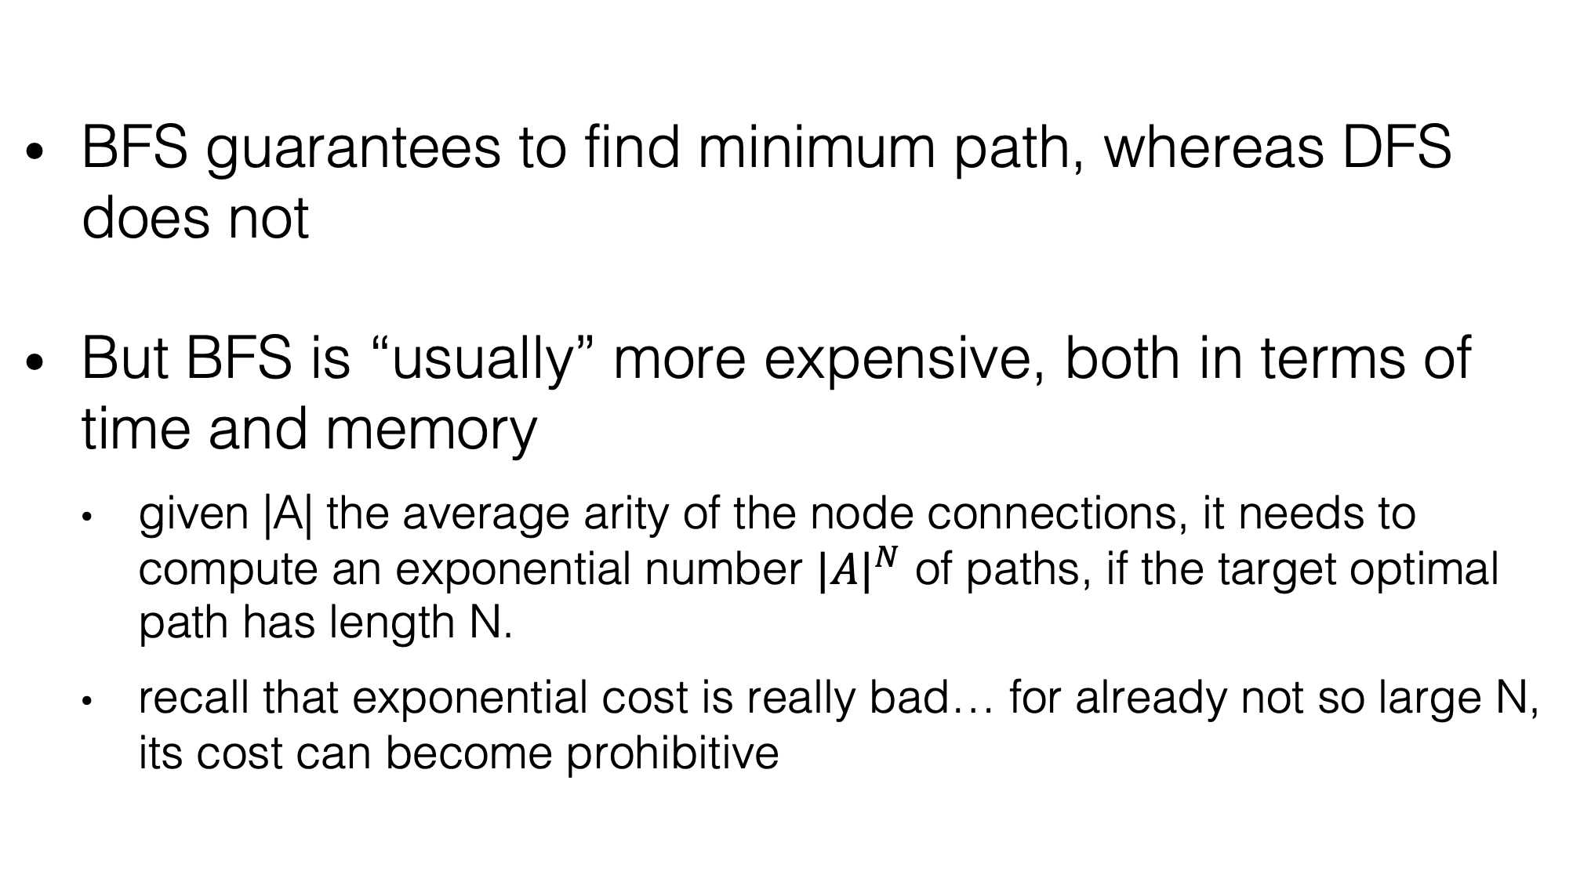
DFS or BFS?
BFS guarantees to find minimum path, whereas DFS does not
But BFS is “usually” more expensive, both in terms of time and memory
given |A| the average arity of the node connections, it needs to compute an exponential number ${|A|}^{N}$ of paths, if the target optimal path has length N.
recall that exponential cost is really bad… for already not so large N, its cost can become prohibitive

Slide 33
Weighted Graphs
You can have graphs where edges have weights
Eg, distance between two cities, road tolls, etc.
Find paths with shortest weight/cost on the traversed edges, even if traversing more vertices

Slide 34
Homework
Study Book Chapter 4.1
Study code in the org.pg4200.les08 package
Do exercises in exercises/ex08
Extra: do exercises in the book

